Slide 1
Checkpoint 26: Introduction to Databases
MySQL, PostgreSQL and SQL SERVER : presentation AnD CoMPARISOn
By: Sirajeddine Bouasker

Slide 2
Overview
Introduction
RDBM
SQL Server
MySQL
PostgreSQL
Comparison
Conclusion

Slide 3


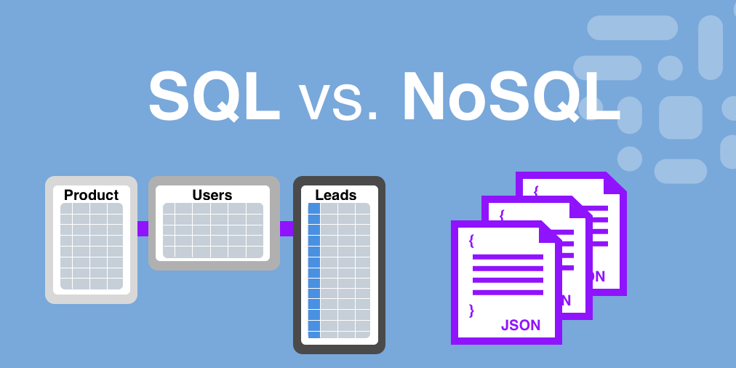
Introduction
What is a database? A database is an organized collection of information
When/why to use databases? Access, Integrity, Security

Slide 4
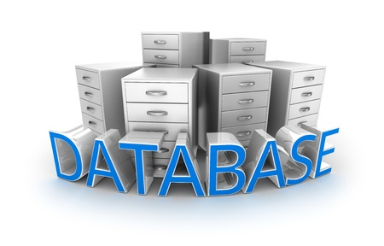
A RACE ?
Which DBMS to use?
SQL/ No SQL ?
Which RDBMS ?

Slide 5
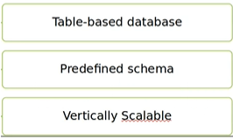
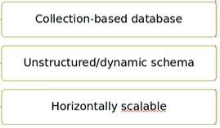
SQL
No-SQL
RDBMS
Better for complex queries
Compatible with many tools
No RDBMS
Better for simple queries
Faster than SQL
ORACLE, MS SQL Server, MySQL, PostgreSQL…
MONGODB, CASSANDRA..

Slide 6
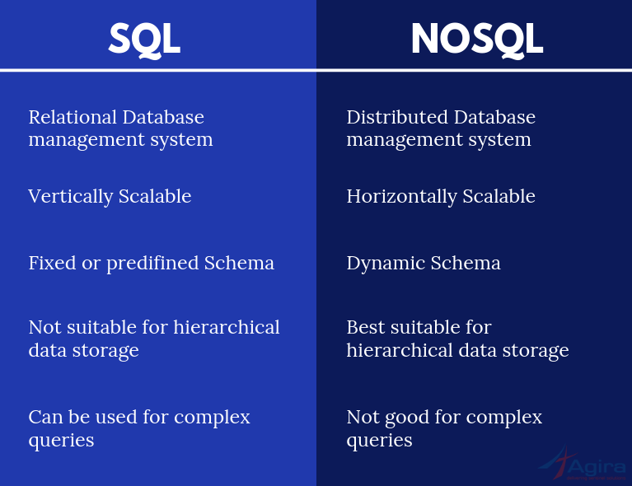

Slide 7
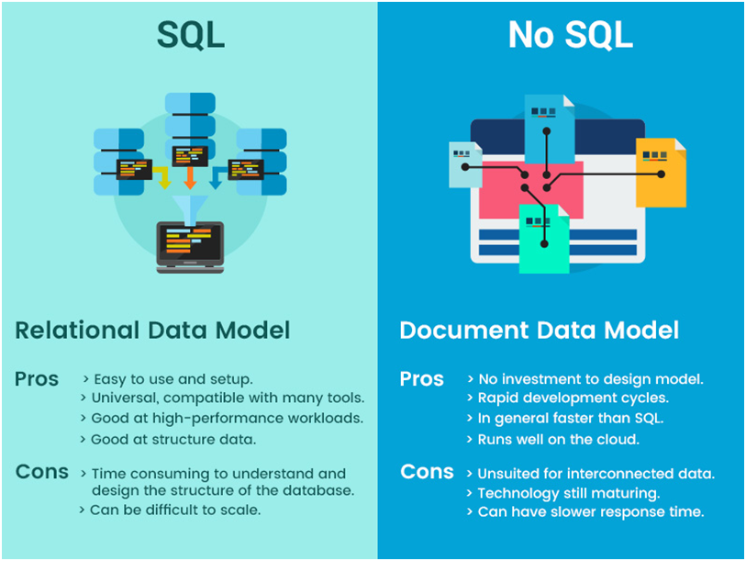

Slide 8

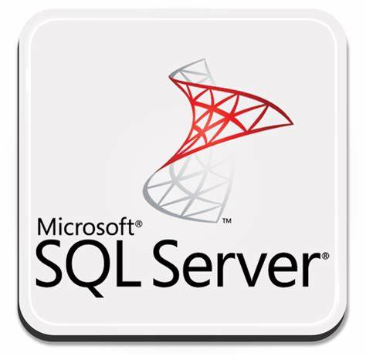

3 of Top 4 RDBMS
1
2
3
According to statistica.com˟ , as of June 2020, the most popular database management system (DBMS) in the world was Oracle, with a ranking score of 1343.59; MySQL and Microsoft SQL server rounded out the top three. However, Oracle is not a pure DBMS, it has many other features, so it is out of our scope, in stead we will take another RDBMS ranked #4: PostgreSQL.
Notes:
© Copyright PresentationGO.com – The free PowerPoint and Google Slides template library

Slide 9
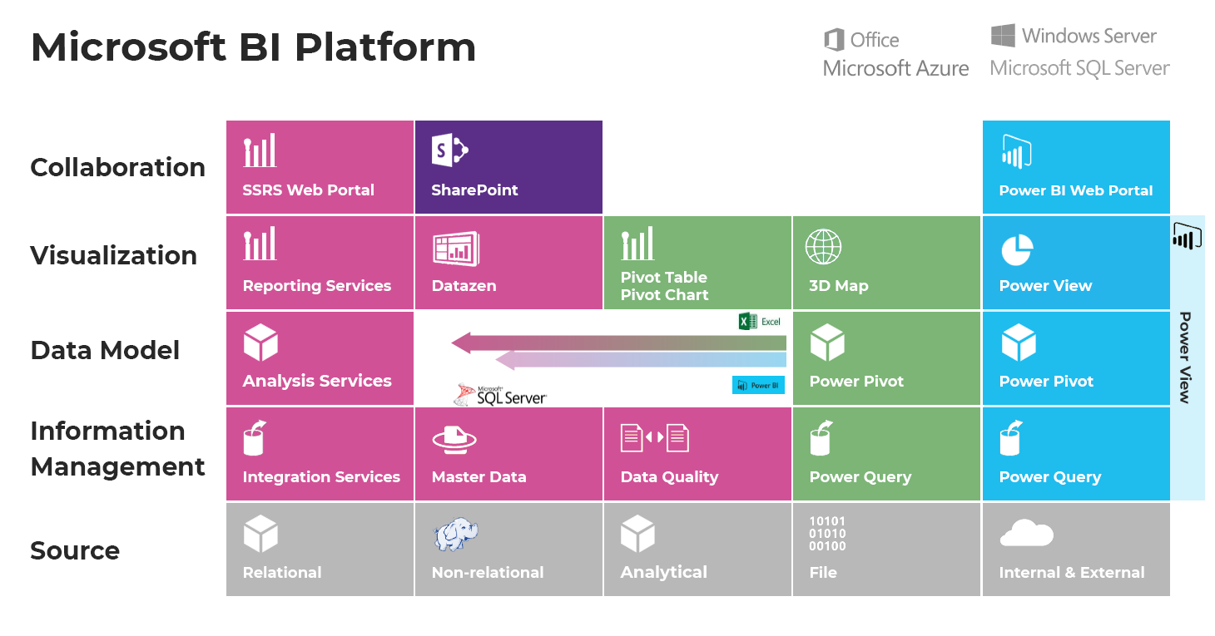
What is MS SQL Server?
SQL Server

Slide 10
SQL Server Editions
SQL Server Edition | Description
Enterprise | The premium offering, SQL Server Enterprise edition delivers comprehensive high-end data center capabilities with blazing-fast performance, unlimited virtualization, and end-to-end business intelligence—enabling high service levels for mission-critical workloads and end-user access to data insights.
Standard | SQL Server Standard edition delivers basic data management and business intelligence database for departments and small organizations to run their applications and supports common development tools for on-premise and cloud—enabling effective database management with minimal IT resources.
Web | SQL Server Web edition is a low total-cost-of-ownership option for web hosters and web VAPs to provide scalability, affordability, and manageability capabilities for small to large scale Web properties.
Developer | SQL Server Developer edition lets developers build any kind of application on top of SQL Server. It includes all the functionality of Enterprise edition but is licensed for use as a development and test system, not as a production server. SQL Server Developer is an ideal choice for people who build and test applications.
Express | Express edition is the entry-level, free database and is ideal for learning and building desktop and small server data-driven applications. It is the best choice for independent software vendors, developers, and hobbyists building client applications. If you need more advanced database features, SQL Server Express can be seamlessly upgraded to other higher end versions of SQL Server. SQL Server Express LocalDB is a lightweight version of Express that has all of its programmability features. It runs in user mode and has a fast, zero-configuration installation and a short list of prerequisites.

Slide 11
Pros and Cons:
SQL Server
Use case | Pros | Cons
Company | Various supported editions Online product documentation Microsoft Premier support On-premises and cloud database support Plenty of tools and applications Support for use on Linux | Expensive enterprise edition ($14,256 for a per-core license) Difficult licensing process that’s always changing
Database specialist | Career opportunities Free developer edition (with all enterprise features) Thriving online community Plenty of online documentation | Complex performance tuning features No native support for source control

Slide 12

MYSQL
What is MYSQL ?
Why is it so Famous?
What are its major differences
compared to sql server?
Notes:
© Copyright PresentationGO.com – The free PowerPoint and Google Slides template library

Slide 13
Key differences between MySQL & SQL Server
Both MySQL and SQL Server are popular choices in the market.
MySQL is mainly used for the PHP projects or applications. SQL server is mainly used for the.Net applications or Windows projects.
In MySQL, there are multiple storage engines which give developers more flexibility to use the engine for the tables based on the performance. One of the popular storage engines is InnoDB. SQL server can use only one or having a single storage engine.
In MySQL, once the query has been executed, it cannot be canceled in mid-way. In SQL server, the query can be canceled in mid-way after the execution.
MySQL does not have any tool which provides security. SQL Server has a security tool which ensures the data security etc. that is MS baseline security analyzer tool.
MySQL is free of cost and free to use. SQL server is licensed and need to purchase licenses to use and run multiple databases. It is really costly to buy multiple licenses.
For MySQL, it is required to pay for getting support or assistance. SQL server has wider community support or online forums. Microsoft support is also paid for providing support to the bSQL server.
If MySQL used with.Net, then third party tools are required to download for getting started. If the SQL server is used with.Net, inbuilt framework classes provide the compatibility and can be started with LINQ queries as well.
MySQL uses the Enterprise manager as IDE tool. SQL server uses the management studio as IDE for developing the queries.

Slide 14
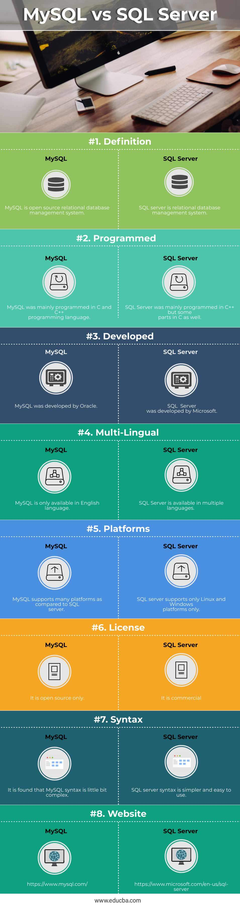
MySQL vs. SQL Server
Notes:
© Copyright PresentationGO.com – The free PowerPoint and Google Slides template library

Slide 15
Advantages & Drawbacks of MySQL
Advantages | Drawbacks
1. MySQL is not as mature as other relational database management systems. MySQL did not start out as an RDBMS (relational database management system), but later changed direction to encompass more functionality. Some more mature RDBMS, like PostgreSQL, are considered more feature-rich. Close source options, like Oracle or Microsoft SQL Server, are also alternatives to consider. 2. MySQL is open source (kind of) Technically, MySQL is an open-source database, but in practice, it no longer feels like it. Under Oracle’s umbrella, MySQL now has proprietary, closed-source modules. 3. MySQL is Oracle-owned instead of community driven MySQL hasn’t changed considerably since it was acquired by Oracle. 4. Big names are jumping ship Red Hat Enterprise Linux, Fedora, Slackware Linux, openSUSE, and the Wikimedia Foundation have all migrated to MariaDB. That’s a pretty compelling argument to ditch MySQL. | 1. There is more MySQL investment and innovation than ever before. Since the acquisition, Oracle has increased the MySQL staff and given it a more mature engineering process where engineering and planning is driven from Oracle instead of people scattered across the world. MYSQL uses InnDB as its major storage engine. InnoDB is also part of the Oracle family, which makes development teams even more integrated. The company is also making code more modular. For example, in MySQL 5.6, they split one of the crucial locks in the MySQL Server, the LOCK_open, which could improve top performance by more than 100%. 2. MySQL products remain solid. Open-source advocates complain that new code in MySQL 5.5 doesn’t have test cases and that some of the enterprise features in version 5.5 are closed source. Still, MySQL 5.6 was well-received as a solid, well-performing product with a number of new features. One of the most notable changes? Going from 4 CPU threads to 64 CPU threads, which nearly tripled the number of concurrent connections from prior versions. Oracle also spent two years releasing Development Milestone Releases (DMR) to the MySQL Community for testing and feedback. 3. MySQL is designed with a focus on the Web, Cloud and Big Data 4. There are more MySQL projects than before. .

Slide 16
PostgreSQL
What is PostgreSQL ?
What are its major differences
compared to MYSQL and SQL server?

Slide 17
Milestone and major functionalities
History of PostgreSQL:
INGRES was developed-1977
Michael Stonebraker and his colleagues developed Postgres- 1986
Support for real ACID and PL/pgSQL - 1990
Released as Postgres95 in -1995
Re-released Postgres95 as PostgreSQL 6.0 - 1996
MVCC, GUC, Join syntax Controls and Procedural Language Loader added- 1998-2001
Version 7.2 to 8.2: Included features like Schema support, Nonblocking VACUUM, Roles and dblink – 2002-2006
PostgreSQL 8.4 released in 2009
PostgreSQL 9.0 released in 2010
NYCPUG (New York City PostgreSQL User Group) joins PgUS (United States PostgreSQL association)- 2013
PGconf organised-2014
Key Features of PostgreSQL:
help developers to build applications
help administrators to build fault-tolerant environment by protecting data integrity.

Slide 18
Most prominent features of PostgreSQL:
Compatible with various platforms using all major languages and middleware
It offers a most sophisticated locking mechanism
Support for multi-version concurrency control
Mature Server-Side Programming Functionality
Compliant with the ANSI SQL standard
Full support for client-server network architecture
Log-based and trigger-based replication SSL
Standby server and high availability
Object-oriented and ANSI-SQL2008 compatible
Support for JSON allows linking with other data stores like NoSQL which act as a federated hub for polyglot databases.

Slide 19
Pros and Cons:
PostgreSQL
Pros
Cons
Rich SQL
Query parallelism
Partitioning
Strong adoption
No compression
No machine learning included
No columnar tables
Slower performance

Slide 20
Recap of PostgresQL
one of the major choices a data scientist can make to store data.
suited to be installed on a computer running Windows.
good for datasets up to 100GB. After that, the lack of compression and columns storage will be too painful and there will be better alternatives.
The migration to more advanced systems is facilitated as many are derived from PostgreSQL (like Amazon Redshift and Greemplum).

Slide 21
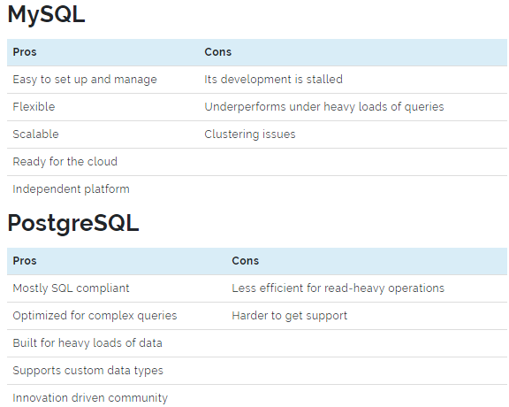
MySQL vs PostgreSQL: An Open Source Battle
Features
Pros and cons
MySQL
Partially compliant with ANSI SQL standards
Object-oriented
The server is available in an embedded database or client-server model
Runs on most UNIX versions
Built-in tools for query and space analysis
Multi-layered design
Independent modules
PostgreSQL
Supports Python and JavaScript
The most common alternative to Oracle
Runs on all major operating systems
MVCC allows for large numbers of users working at the same time
Allows for flexible data retrieval through table joins and views
Uses replication to backup data
Its indexing is extensive, allowing for high-complexity reporting

Slide 22
Comparison

Slide 23
CONCLUSIOn
Companies using MySQL
Google
Udemy
Netflix
Airbnb
Amazon
Pinterest
MySQL, is the most demanded database on the market, which means finding competent teams, learning resources, reusable libraries, and ready add-ons will be easy. So, if you are choosing between SQL Server vs MySQL in terms of market trends, the latter is a better choice.
MySQL is widely used by big corporations and governmental organizations. Over the last 25 years, the solution has built a reputation of a reliable database management solution, and as time shows, it’s indeed capable of supporting long-running projects.

Slide 24
Companies that use PostgreSQL
Apple
Skype
Cisco
Etsy
Companies using SQL Server
JPMorganChase
Bank of America
UPS
Houston Methodist
Postgre is known for its intuitive functionality and versatile security settings. This is why its main use cases are governmental platforms, messenger applications, video chats, and e-commerce platforms.
SQL Server is a go-to choice for large enterprises that have vast business logic and handle multiple applications simultaneously. Teams that prioritize efficiency and reliability over scalability and costs typically choose this database. It’s a common option for “traditional” industries – finances, security, manufacturing, and others.

Slide 25
MERCI POUR VOTRE ATTENTION

